Slide 1


Shop2Earn
Shop and Resell
Asfahan Shah E19CSE116
Aniket Purkayastha E19CSE151
Saksham Khandelwal E19CSE216
Atindra Shekhar E19CSE187
Sadhil Chhabra E19CSE299
Pranjal Gupta E19CSE360

Slide 2

Overview
This COVID-19 pandemic has affected a lot of people in the past few months. Two of the mostly affected groups were the small manufacturers and businessmen along with the working/middle class people where many went unemployed or laid off.
Our online platform will connect these two groups, where the manufacturers will put up their products, and the individuals with their intension to earn will advertise them through their own social media handles and resale, the products keeping the extra commission as their earning. This will not only help the enterprises to sell online but also encourage the working class to boost their financial gain by enhancing their reselling business.

Slide 3

What is the need?
To boost the economy of Small-Scale Businesses.
To increase the market of the Small-Scale Businesses.
To supplement the economy of those people who were recently laid off from there jobs.
To provide good quality products to customer.

Slide 4

Why there is this need?
Due to Lockdown
Small-Scale businesses do not have financial support
Customers are more prone to shop from branded ventures leaving behind the SMEs to starve

Slide 5


Whose Need?
Small Scale Businesses (Homemade Artifacts, Handicrafts etc.)
Jobless Individuals (Mainly Students, Housewives, people that were laid off from there jobs etc.)
Consumers of the product

Slide 6

Problem Statement
SME's lack financial support to properly advertise their products and to increase their market outreach moreover, due to stiff completion from big e- commerce giants, people are not buying products from SME’s.
Because of COVID-19 pandemic and consequent change in buying habits (online mode of buying) there condition has already worsened and many sme's are at the verge of closure.

Slide 7
How Big is the problem?
An estimated 12.2 crore people have lost their jobs due to the Covid-19 pandemic in India.
Source: India Today

Slide 8
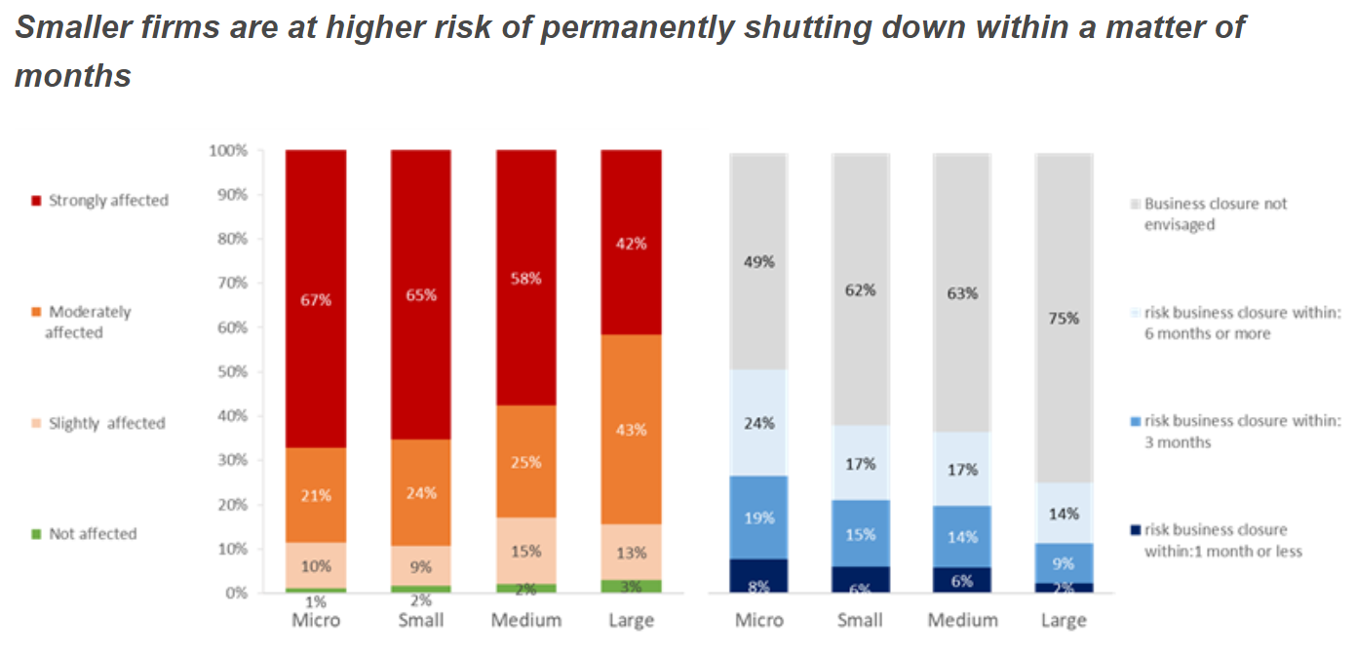
In a June survey by the All-India Manufacturers Organization, about one-third of small and medium-sized enterprises indicated that their businesses were beyond saving.
The credit rating agency has warned in its study that coronavirus crisis will knock off a fifth of the revenues of small and medium enterprises (SMEs), as the Indian economy is pegged to shrink 5% in FY21 owing to weak demand due to COVID-19 pandemic and the subsequent lockdown.
Source: intracen

Slide 9

Define Opportunity
The small-scale industries have shown tremendous growth in their number, production, employment and exports. The below data justifies the facts -
Number of SMEs in India: The number is estimated to be at 42.50 million, registered & unregistered together. A staggering 95% of the total industrial units in the country.
SME & Employment opportunity: Employs about 106 million, 40% of India’s workforce. Next only to the agricultural sector.
Products: produces more than 6000 products.
GDP Contribution: Currently around 6.11% of the manufacturing GDP and 24.63% of Service sector GDP.
SME Output: 45% of the total Indian manufacturing output.
SME Exports: 40% of the total exports.
Bank Lending: Accounts for 16% of bank lending.
Fixed Assets: Current fixed assets at INR 1,471,912.94 crore.
SME Growth Rate: Has maintained an average growth rate of over 10%.
Source: evoma

Slide 10

During this pandemic there has been a swift change in the trend of customer needs which has seen a drastic shift from offline to online shopping.
Flipkart and amazon have recorded a huge number of sales in this covid-19 pandemic.
Source: Business Standards
The role of SME in the economy is important.
SME & Employment opportunity: Employs about 106 million, 40% of India’s workforce. Next only to the agricultural sector.
GDP Contribution: Currently around 6.11% of the manufacturing GDP and 24.63% of Service sector GDP.
Source: evoma
As mentioned in the above graphs SME’s have suffered a massive loss due to the pandemic on the top of that not being in the online domain has become a major disadvantage for these industries so much as they are on the verge of shutting down but at the same time, we got this massive opportunity to bring these SMEs into online domain

Slide 11
SWOT Analysis
Strengths - - Continuous source of income for SME - Reduction in operating cost for SME - Reach up to local level
Weaknesses - - Weak brand name - Focusing on only one product - Limited reach
Opportunities - - Increase in the market reach - Diversifying our products - Changing mentality of traditional SME
Threat - - Government regulations - Increasing cybercrime - Imitation

Slide 12
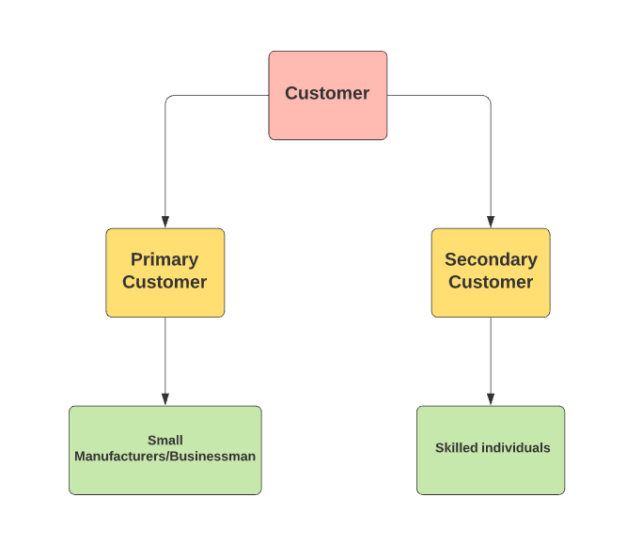
Target Customer

Slide 13
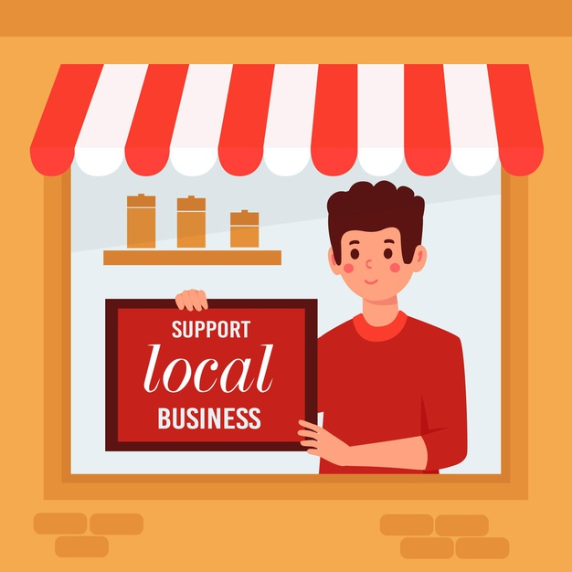
Primary Customer
Small Manufacturers/Businessman
Age-
Above 18 years
Description-
- HANDICRAFTS & COTTAGE INDUSTRIES
Revenue – Less than the average SME revenue in India.
Employees – Around 30 to 200
Technologically aware
Relatively new
Interest-
To increase their market reach.
Challenges-
Coronavirus outbreak has crushed demand, upended supply chains.
Transformed consumer habits(mainly online mode of shopping).

Slide 14

Secondary Customer
Skilled Individuals
Age-
18 to 60 years.
Description-
Should have good communication skills
Proficient in English
Proficient in native language
Technologically aware
Interest-
To find a viable source of income
Challenges-
To boost their financial status/condition.

Slide 15

Total available markets –
The Total Available Market for Shop2Earn are the SMEs whose number in India is estimated to be at 42.50 million, registered & unregistered together. A staggering 95% of the total industrial units in the country.
Source: evoma
Serviceable Available Market -
Our total serviceable available market will mainly constitute a handicraft and cottage industries.
Approx. 17 Million registered & unregistered together.
Source: India Today
Share of Market –
Our share of market that we can realistically reach is the northern part of India.
Approx. 5.44 million registered & unregistered together.
Source: India Today

Slide 16
Competitor | Strength | Weakness | Differentiation
Flipkart | Popular among online buyers Trust factor (flipkart assured) | High competition for new sellers. Non-returnable products may often result in agitation among customers in case of defective products. | Focus is on selective industries reducing competition for new sellers. Every product has a return policy.
Amazon | Popular among online buyers Trust factor (amazon fulfilled) International brand name recognization | High penalties for sellers if genuinely an item is out of stock or fails quality test to be shipped High competition for new sellers. | Chances of going out of stock is less as we buy the products in wholesale as per the demands. Focus is on selective industries reducing competition for new sellers.
IndiaMART | India’s well known wholesale seller Efficient as it just connects businesses and leaves it to up to buyer and seller how they want to deal with each other | Indiamart is into too many product range making it cluttered. Thus, clients who are highly focused and want to work on websites that specializes on only their industries will avoid it. Lack of aggressive advertisement. | Specializes in handicraft industry. Promotion of our products by the resellers through their social media makes the advertisement more effective.
Competition

Slide 17

Solution/Product or
Service Description
We provide a web based online platform that helps both sme's and skilled individuals known as resellers to earn profit.
They(sme's and skilled individuals) both have to register in our website where sme’s will have to put up their products on our platform for selling purposes and then the resellers will be advertising these products through their social media handles from where end customers will be able to order products.
Depending upon the type and the price of product the resellers will get commission as pre-defined.

Slide 18
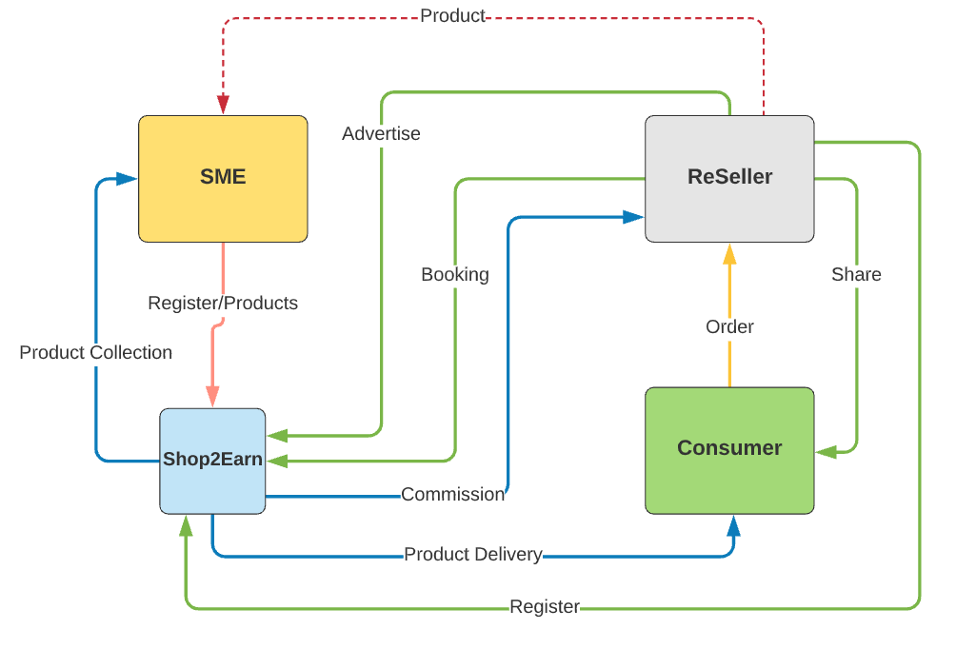
Flow-Chart

Slide 19
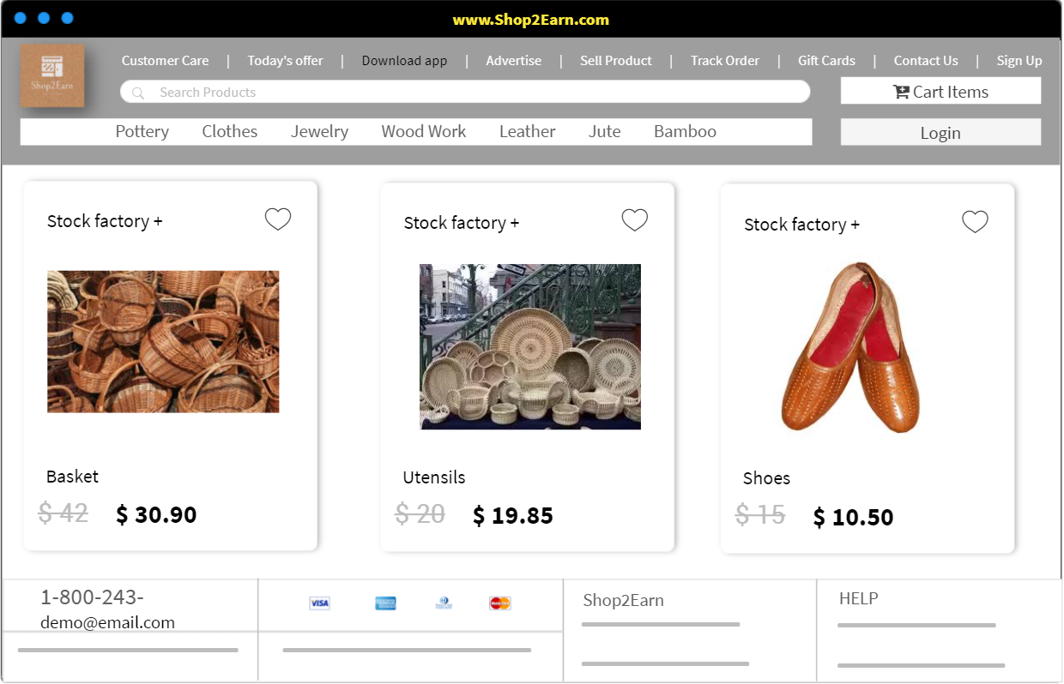
Mock-up UI

Slide 20
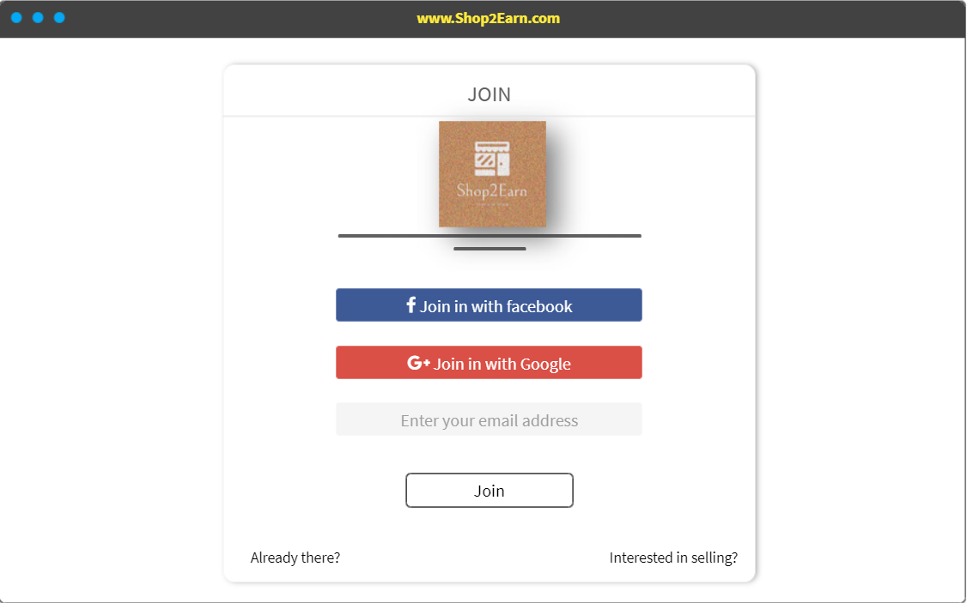
Mock-up UI

Slide 21
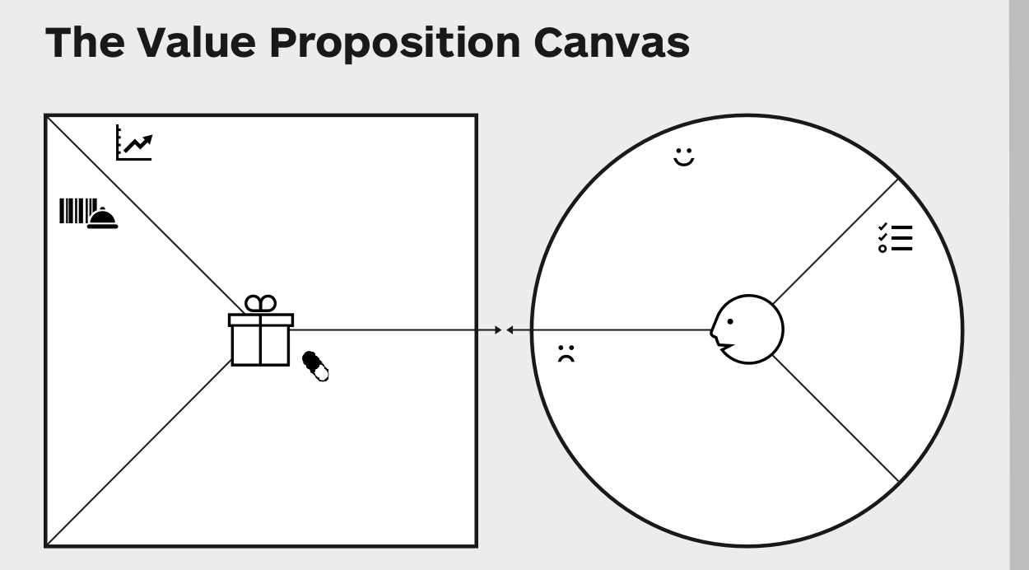
Gain Creators
Gains
Use of e-commerce technology to reach wider audience.
A fixed amount of purchase from the SMEs, guaranteeing them continuous flow of income source.
User friendly system
Increase in the advertisement opportunities.
Continuous source of income
Reduction in operating costs.
Hassle free process.
Products & Services
Customer Jobs
Increase their market potential
To increase their revenues
Easy-to-use UI.
24x7 customer service.
Reasonable profit margin depending upon the demand in market.
Pains
Pain Relievers
Lack of financial resources
Limited Market Access.
Inefficient use of Information Technology.
High and variable commissions taken by the third party.
Increases the advertisement and marketing opportunities by bringing these SMEs to e-commerce fold.
Sustainable and steady source of income.
B2B business without any involvement of third-party member.

Slide 22
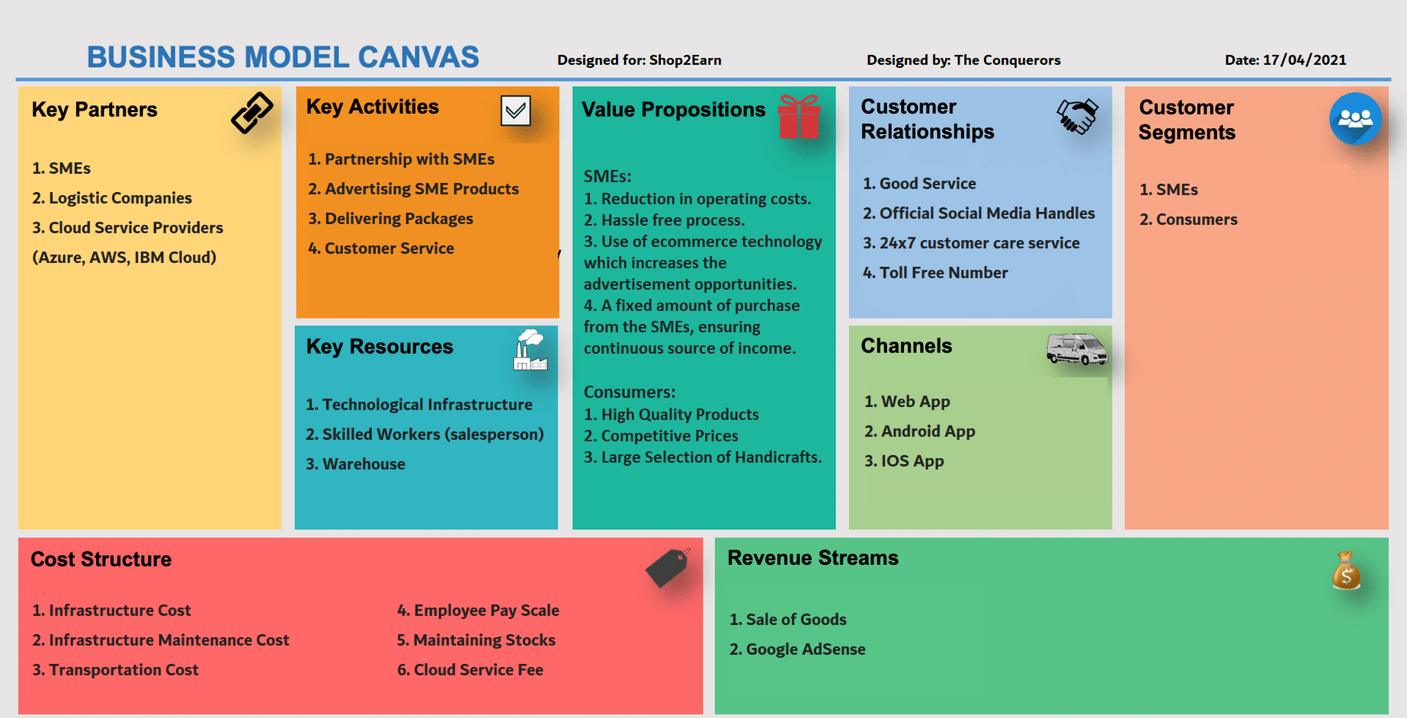
Business Model Canvas

Slide 23
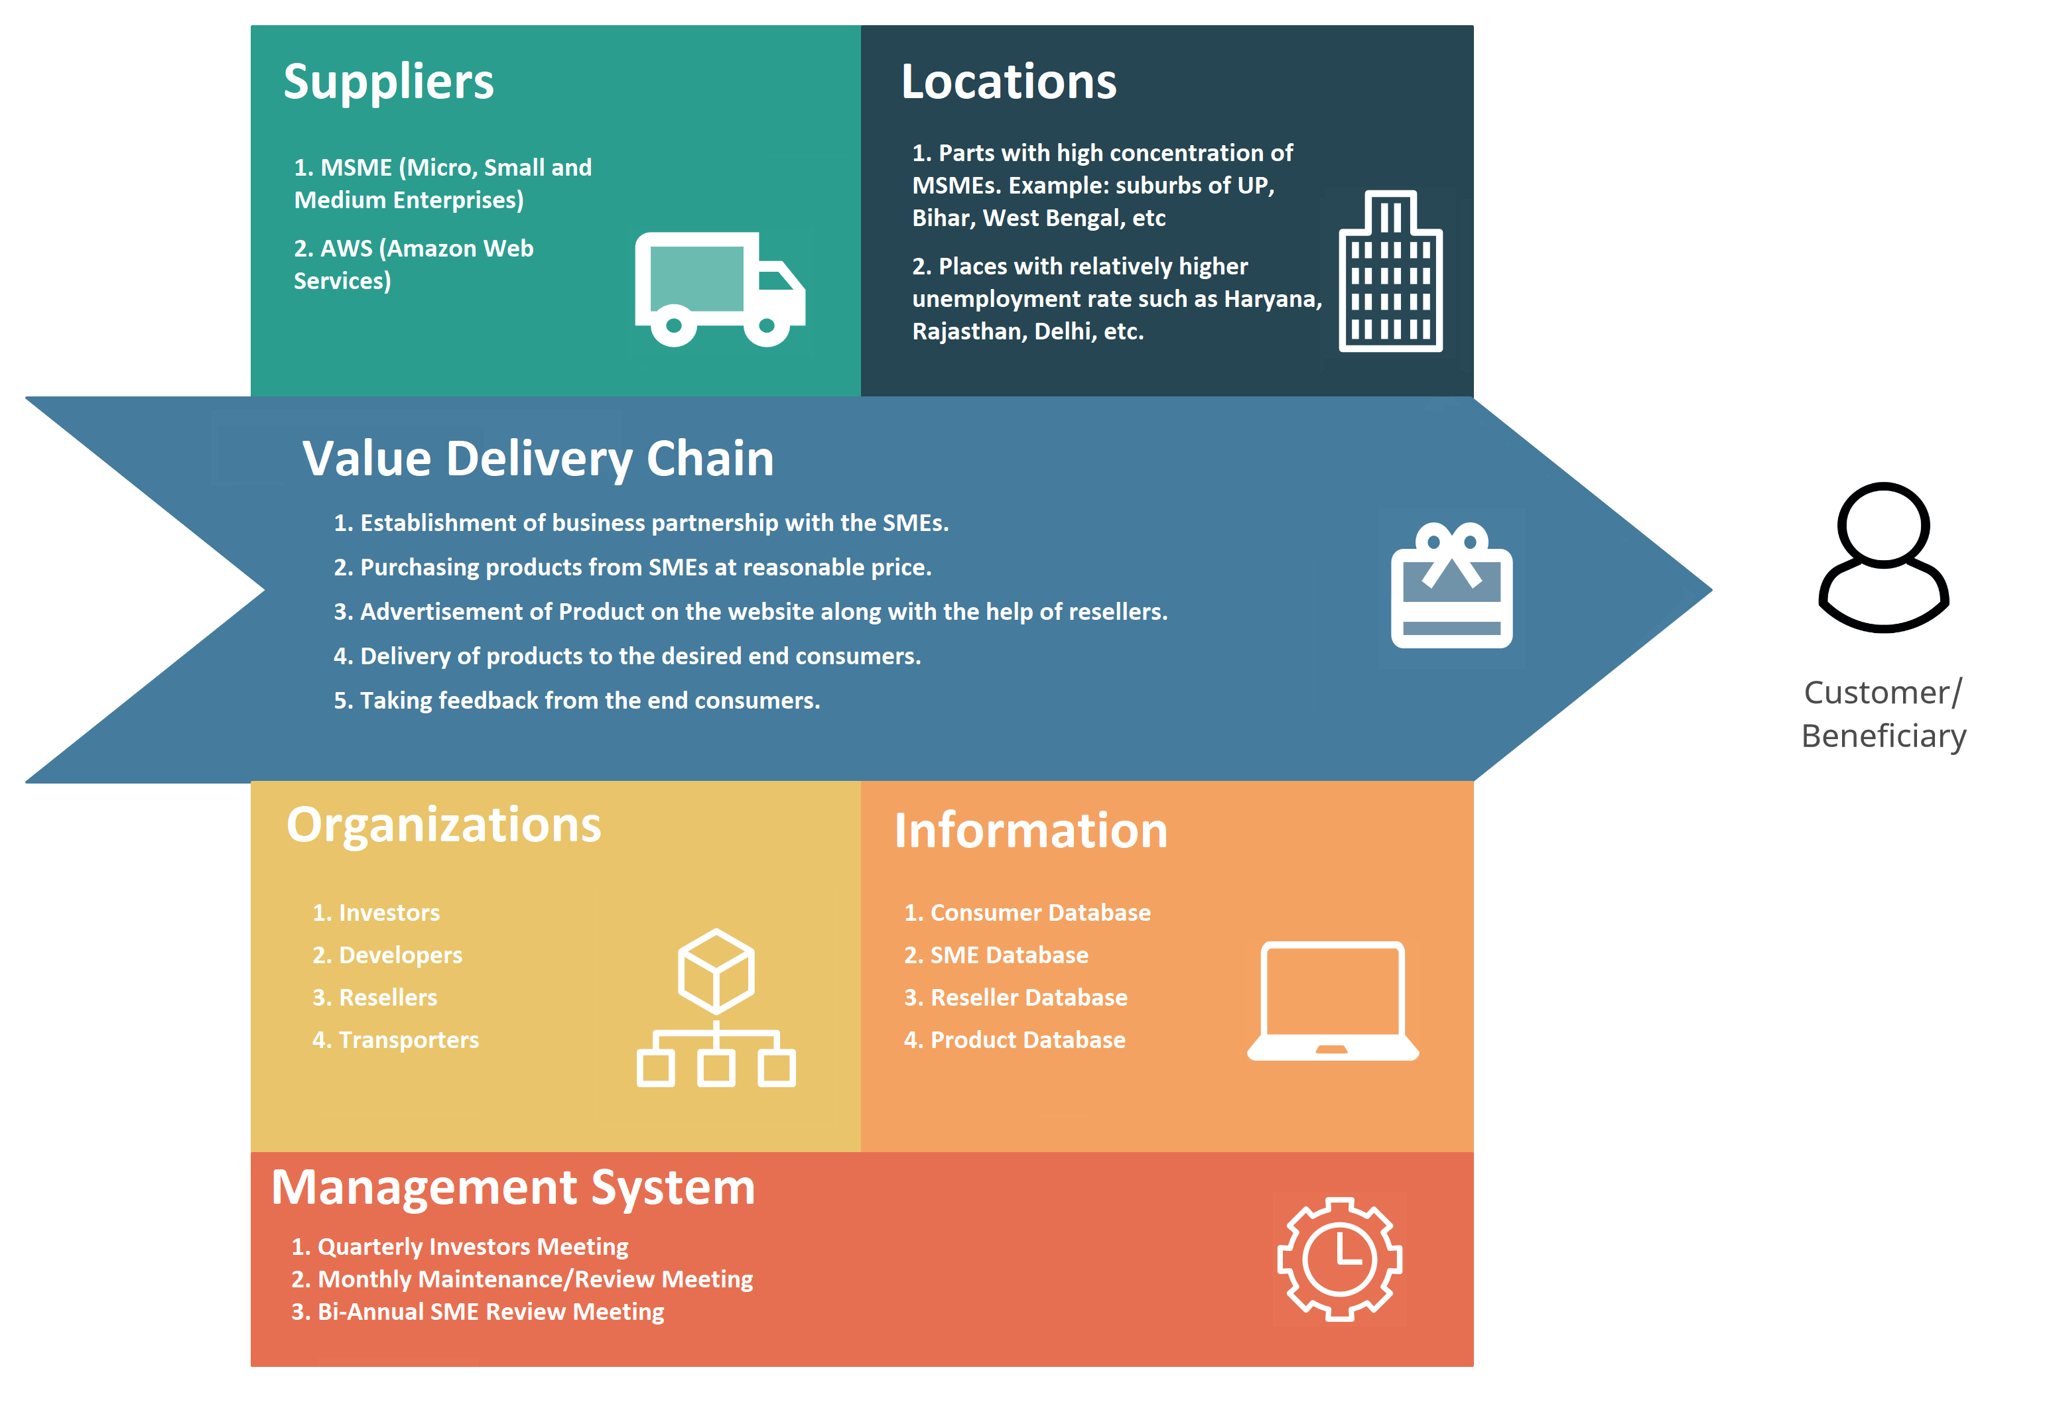
Operating Model Canvas

Slide 24
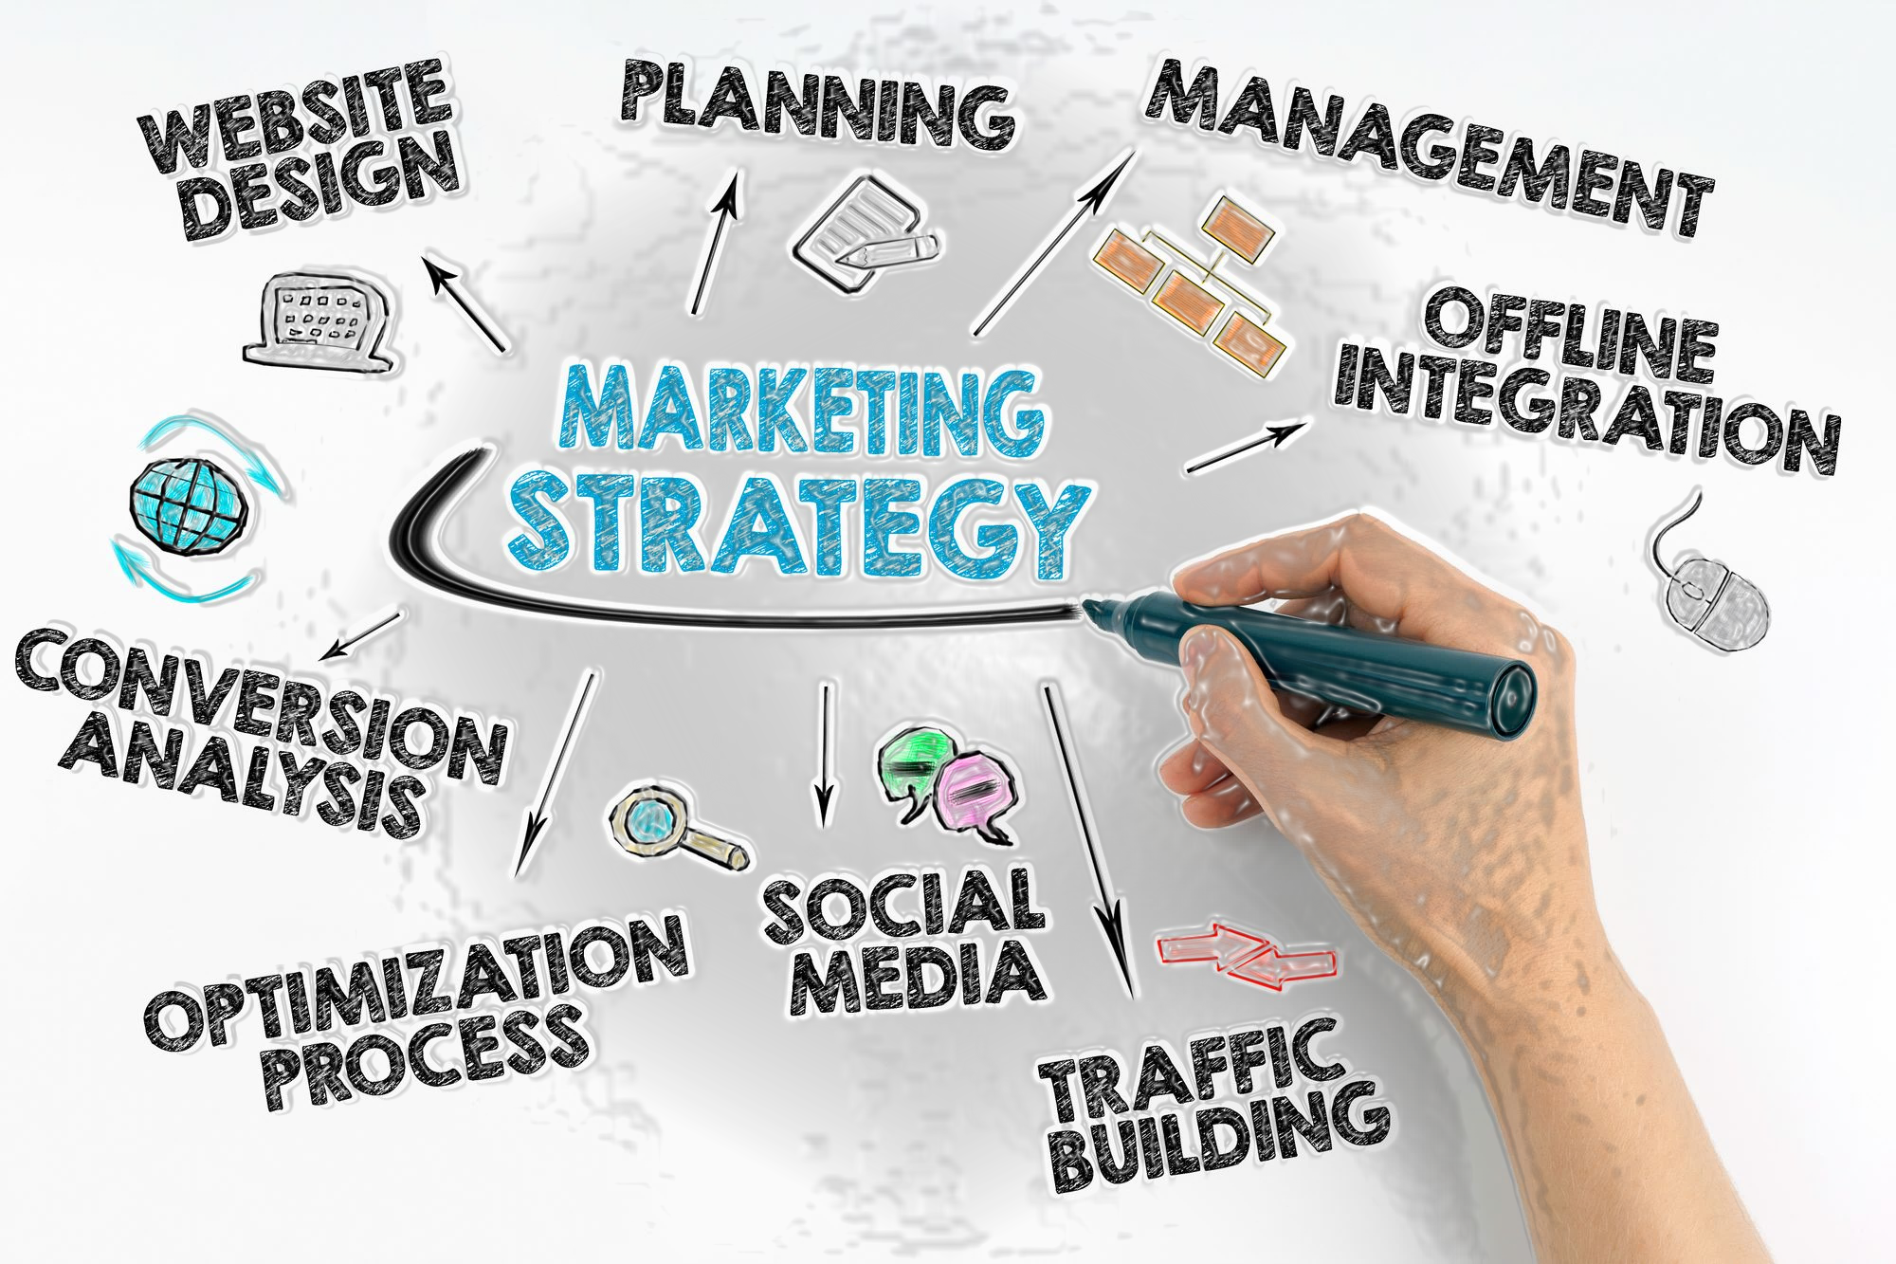
Marketing Strategy
Offering advertisement and marketing options to the financially struggling MSMEs ensuring continuous financial flow.
Offering employment opportunities to the unemployed and financially weaker section of the society.
Advertising through our online portals.
Reaching our end consumers through reseller's social media handles used for advertising our products.
Using Consumer Feedback Analysis to make necessary developments in marketing strategy.

Slide 25

Financial Strategy
Revenue Sources:
Profits earned from Sale of Products
Google Ad Sense
Cost Incurred:
Infrastructure Cost
Infrastructure Maintained Cost
Transportation Cost
Employee Pay Scale
Maintaining Stocks
Cloud Service Fee
Break-even point: 6-7 Years

Slide 26
Financial Strategy
Reasons:
Time to establish brand name and trust factors.
Expected another 5-7 years for the SMEs to strengthen their root hold over the market. (Average growth rate of SMEs: over 10%).
Financially weak SMEs being digitally inefficient still requires few years to become technologically aware.

Slide 27
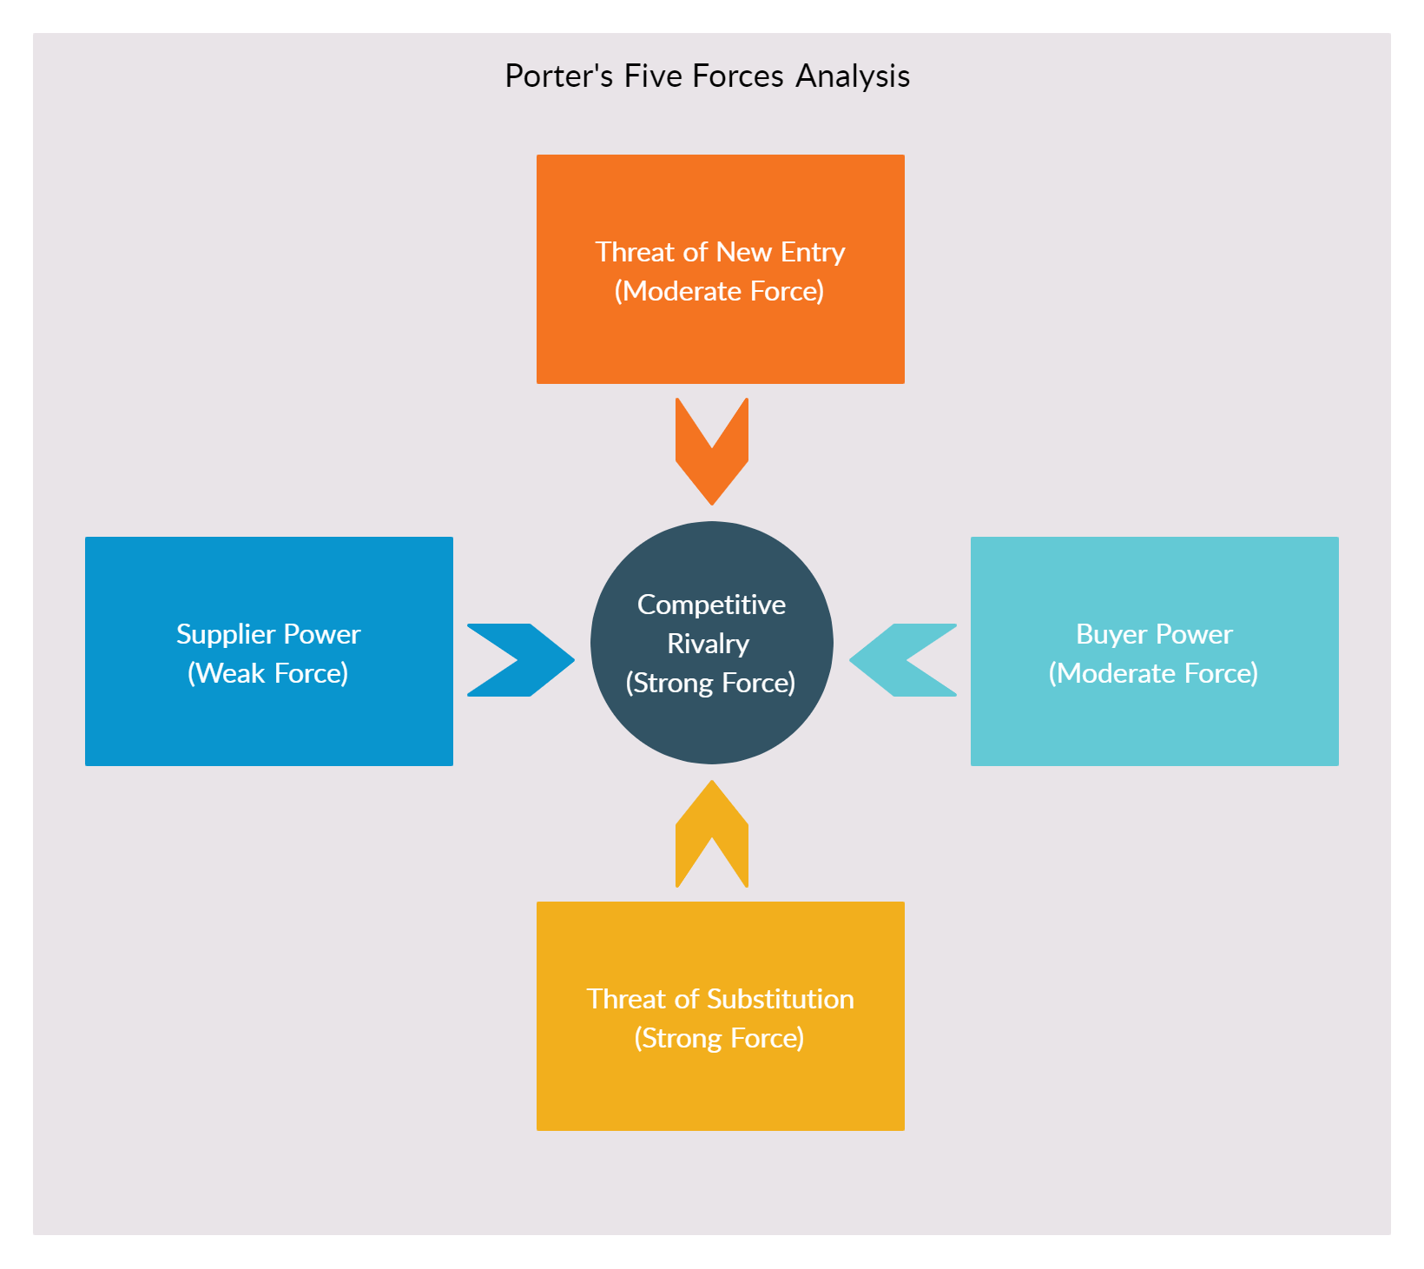
Porter’s Five Forces Analysis

Slide 28

Porter’s Five Forces Analysis
Competitive Rivalry (Strong Force):
Shop2Earn can face indirect rivalry from ecommerce giants like Flipkart, Amazon and IndiaMART.
These e-commerce giants being popular among the online buyers along with high trust factors and brand value impose a strong rivalry for Shop2Earn.
Besides delivering products online our focus is also on helping small SMEs and skilled but unemployed individuals financially with the unique feature of reselling business hence, giving a small upper hat over our rivals.
The above-mentioned e-commerce giants somewhere prioritise established businesses and cornering small SMEs.

Slide 29

Porter’s Five Forces Analysis
Threat of substitutes (Strong force):
Instead of buying from shop2earn, customers can easily buy products from the local markets because of the high availability of the local retailers.
Because of high popularity and brand value e-commerce giants can always be an alternative for the customers and for the SMEs.

Slide 30
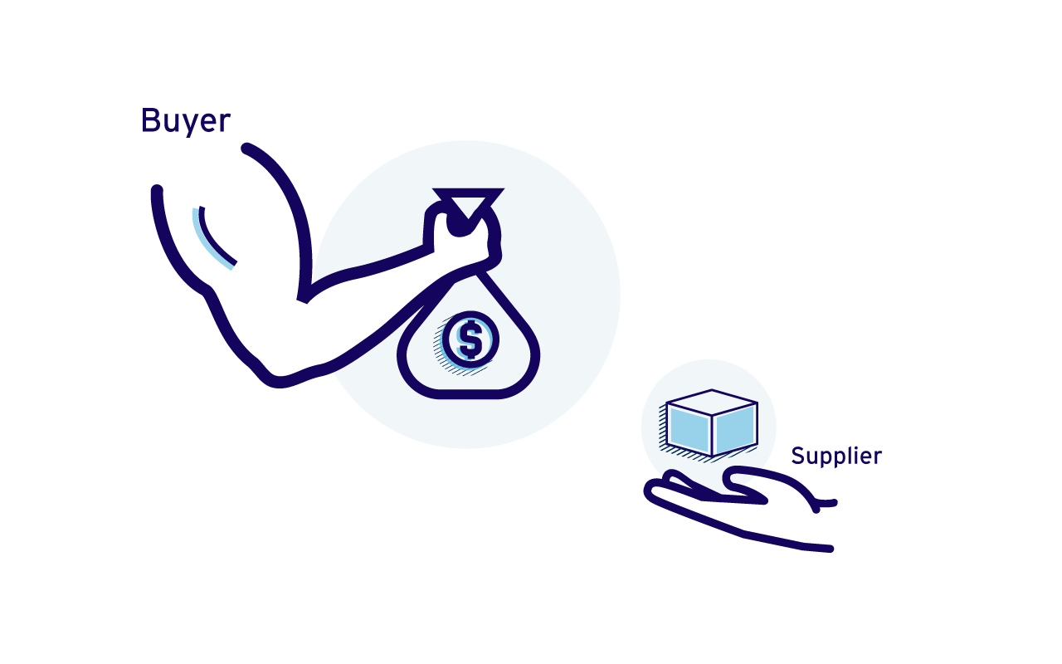
Porter’s Five Forces Analysis
Bargaining Power of Customers (Moderate Force):
Availability of substitutes in form of e-commerce giants may empower the customers by providing them multiple alternatives to buy products.
Despite of these alternatives when it comes to handicraft products the choices become limited for the customers which is fulfilled by shop2earn hence limiting the bargaining power.

Slide 31
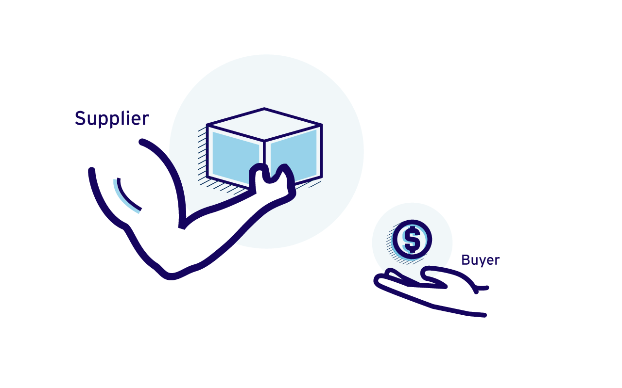
Porter’s Five Forces Analysis
Bargaining Power of Suppliers (Weak Force):
As more and more SMEs are struggling financially, we get the opportunity to make them aboard our business as a supplier and hence providing a large population of suppliers for us.
Due to the large population of suppliers, Shop2Earn gets more option to select from and hence limiting their influence on the company along with their bargaining power giving us the upper hand.

Slide 32

Porter’s Five Forces Analysis
Threat of New Entrants (Moderate force):
Customers can easily switch from one online retail to another.
Although, starting from the scratch and establishing their infrastructure and building brand value is a time consuming and expensive affair for any new industry.

Slide 33

Team Members Roles and Responsibilities
Asfahan Shah → Marketing head and Research Head
Aniket Purkayastha → Founder and Project Manager
Saksham Khandelwal → Co – Founder and Research Co – Head
Atindra Shekhar → Technical Co – Head
Sadhil Chhabra → Design Head
Pranjal Gupta → Technical Head

Slide 34
Team
Asfahan Shah → Hi I, am Asfahan Shah. I am Marketing head and Research Head of Shop2Earn. My main role was Market Research and the background research.
Saksham Khandelwal → Hi I, am Saksham Khandelwal. I am the co founder of Shop2Earn and research co-head. I do research related to our customers like SME and unemployed individuals collect their data.
Aniket Purkayastha → Hi I, am Aniket Purkayastha. I am Founder and Project Manager of Shop2Earn. My role was managing the development of our product Shop2Earn.
Atindra Shekhar → Hi I, am Atindra Shekhar. I am Technical Co – Head of Shop2Earn. My role was developing necessary functionalities required for our project Shop2Earn.
Sadhil Chhabra → Hi I, am Sadhil Chhabra. I am Design Head of Shop2Earn. My role was designing the Front-End aspects of Shop2Earn.
Pranjal Gupta → Hi I, am Pranjal Gupta. I am Technical Head of Shop2Earn. My role was maintaining the necessary Data and combining Front-End and Back-End of Shop2Earn.

Slide 35
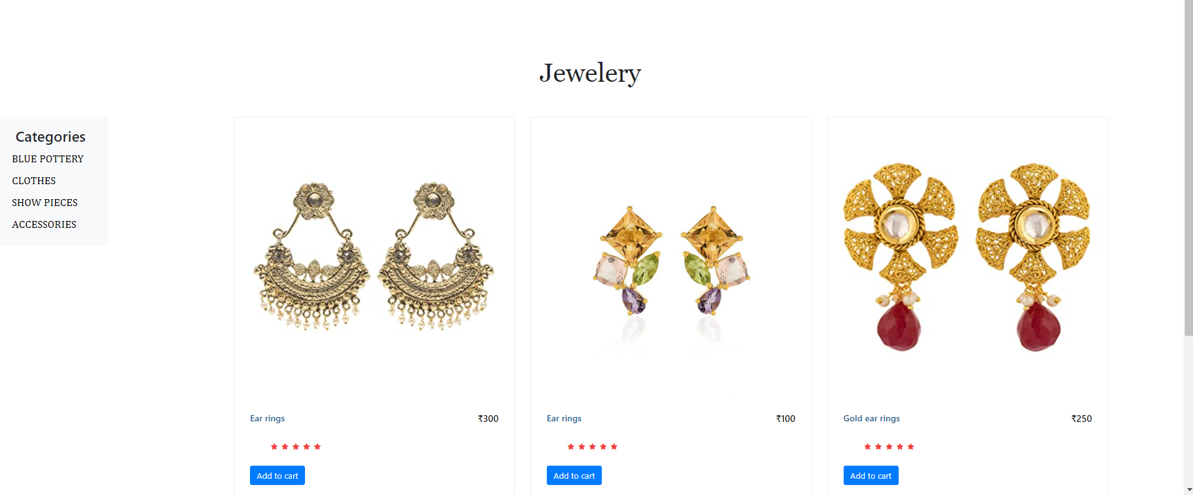
Milestones (Website Snapshots)

Slide 36
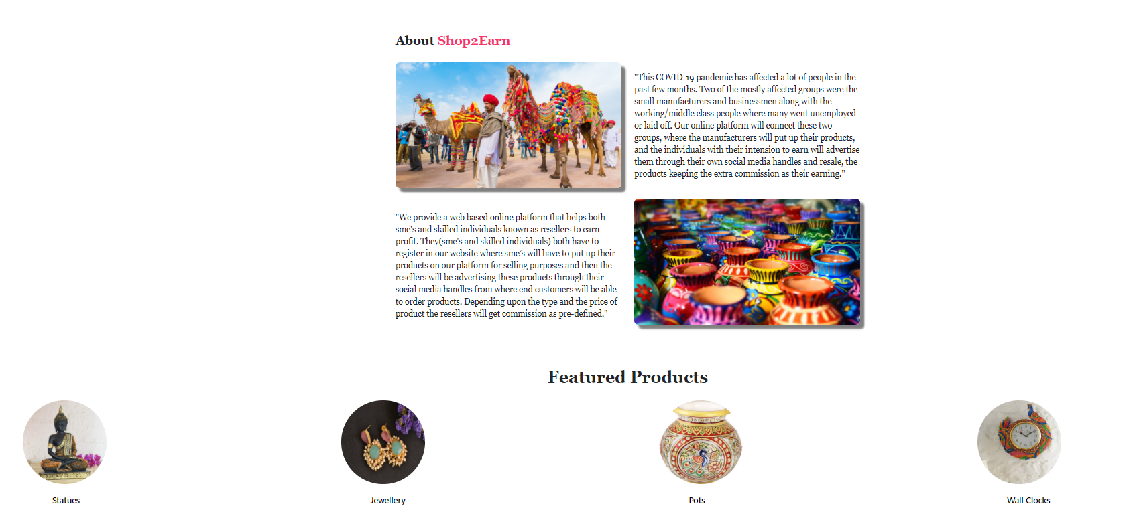
Milestones (Website Snapshots)

Slide 37

Milestones(Future Works)
Applying for patent and trademark.
Launching the website and making it functional.
Taking customer feedbacks and applying necessary modifications.
Extending our market reach up to the National level.

